Slide 1
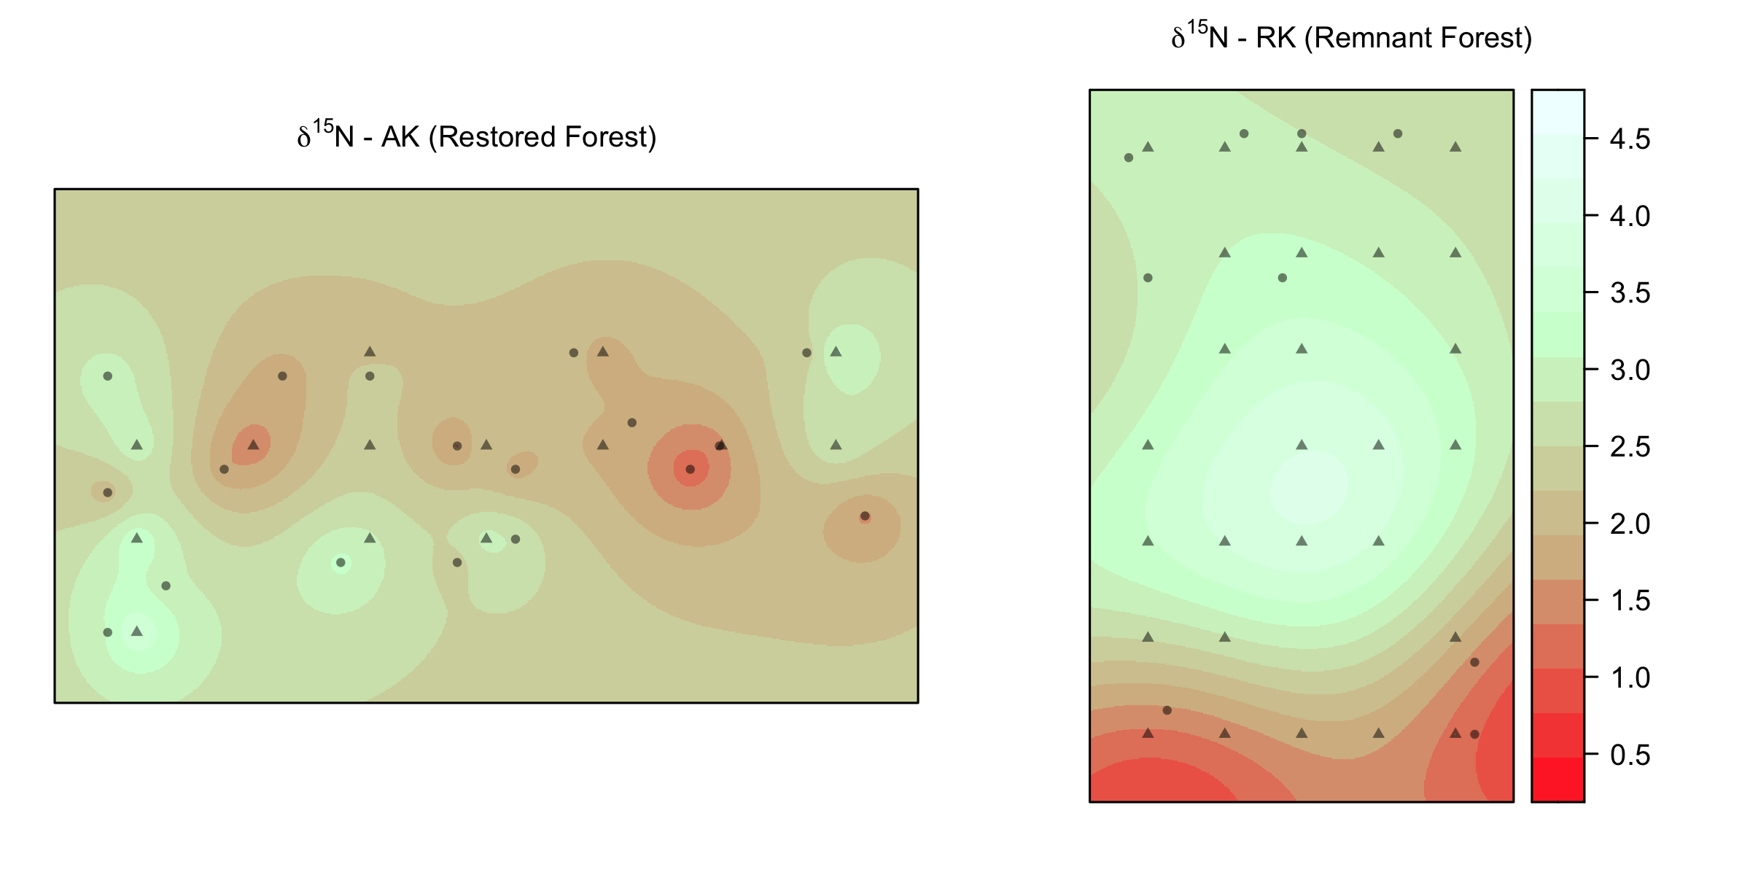
(a)
Foliar nitrogen isoscape
Koa Plantation (KP)
(b)
Remnant Forest (RK)
δ¹⁵N ‰
5 m
A. koa
Rubus spp.
N

